Slide 1

Women and the crime of bigamy, 1603-2023
Professor Rebecca Probert
University of Exeter

Slide 2

A comical crime?

Slide 3
Tonight’s talk
The changing parameters of the crime
The changing punishment of the crime
The changing conceptualisation of the crime
Women as perpetrators
Women as victims

Slide 4
The changing parameters of the crime

Slide 5
An Act to restrain all Persons from Marriage, until their former Husbands or Wives be dead
‘if any Person or Persons within his Majesty’s Dominions of England and Wales, being married… marry any Person or Persons, the former Husband or Wife being alive; That then every such Offence shall be Felony…’

Slide 6
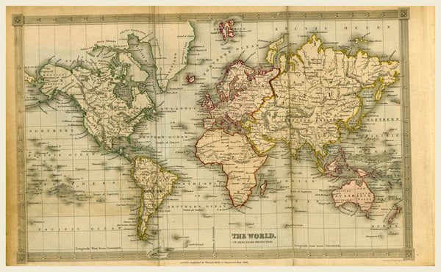
Exceptions for those
‘whose Husband or Wife shall be continually remaining beyond the Seas by the Space of seven Years together, or whose Husband or Wife shall absent him or herself the one from the other by the Space of seven Years together, in any Parts within his Majesty’s Dominions, the one of them not knowing the other to be living within that Time’

Slide 7
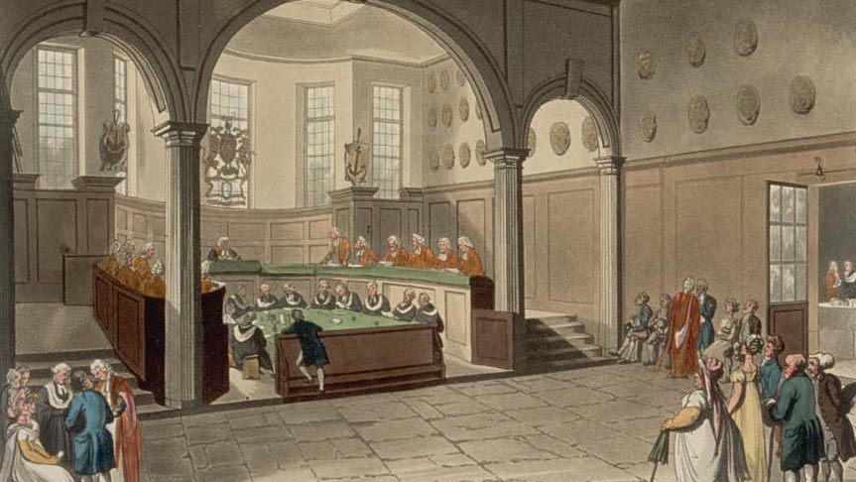
And for those
‘divorced by any Sentence had or hereafter to be had in the Ecclesiastical Court’
or where ‘the former Marriage hath been or hereafter shall be by Sentence in the Ecclesiastical Court declared to be void and of no Effect’

Slide 8
Margaret Porter’s case,1636
Remarriage after a separation a mensa et thoro on the ground of her husband’s cruelty
‘if this should be suffered, many would be divorced upon such pretence, and instantly marry again, whereby many inconveniences would ensue’

Slide 9
Offences against the Person Act 1828
Scope of seven-year exception narrowed - clarified that an individual would only have a defence if they had no reason to believe that their spouse was alive during that time, regardless of where they were
Divorce a mensa et thoro no longer sufficient; had to be a divorce ‘from the bond of marriage’

Slide 10
The changing punishment of the crime

Slide 11

The use of transportation as punishment for bigamy
1604 Act: ‘the Person and Persons so offending shall suffer Death as in Cases of Felony’
  Mitigated by benefit of clergy
  Branding
  Brief period of imprisonment/fines
1795 Act: Transportation for 7 years or 2 years’ imprisonment
1861 Act: 3-7 years’ penal servitude or up to 2 years’ imprisonment
Shift from the death penalty in the c17th to branding in the c18th
Brief period in which bigamy was treated leniently
New legislation in 1795 provided for transportation or up to two years’ imprisonment

Slide 12
The changing conceptions of the crime

Slide 13
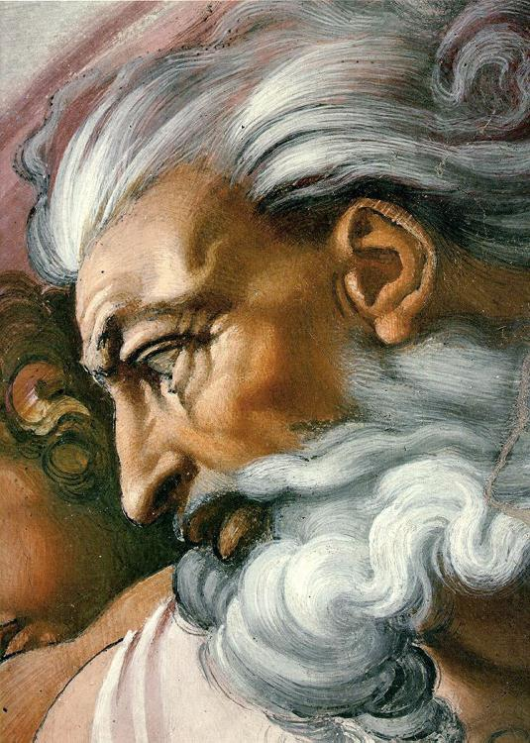
An offence against God
‘‘Forasmuch as divers evil disposed Persons being married, run out of one County into another, or into Places where they are not known, and there become to be married, married, having another Husband or Wife living, to the great Dishonour of God….”

Slide 14
An offence against ‘the public police or oeconomy’
‘By the public police and oeconomy I mean the due regulation and domestic order of the kingdom: whereby the individuals of the state, like members of a well governed family, are bound to conform their general behaviour to the rules of propriety, good neighbourhood, and good manners; and to be decent, industrious, and inoffensive in their respective stations. This head of offences must therefore be very miscellaneous, as it comprizes all such crimes as especially affect public society, and are not comprehended under any of the four preceding species’ (Blackstone, Commentaries on the Laws of England, Vol 4)

Slide 15
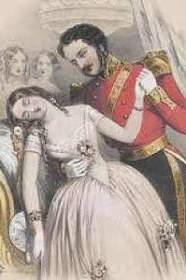
An offence against the person
‘few crimes can be more atrocious than that of a married man, who by representing himself to be a bachelor, prevail on a modest woman to become his wife. He possesses himself by fraud of her person…’ (Sir Samuel Romilly)

Slide 16
Women as perpetrators

Slide 17
c17th and early c18th: women account for approximately 30% of those prosecuted for bigamy; high percentage acquitted
Late c18th: drop in the percentage of women being prosecuted for bigamy, but increase in the percentage convicted

Slide 18
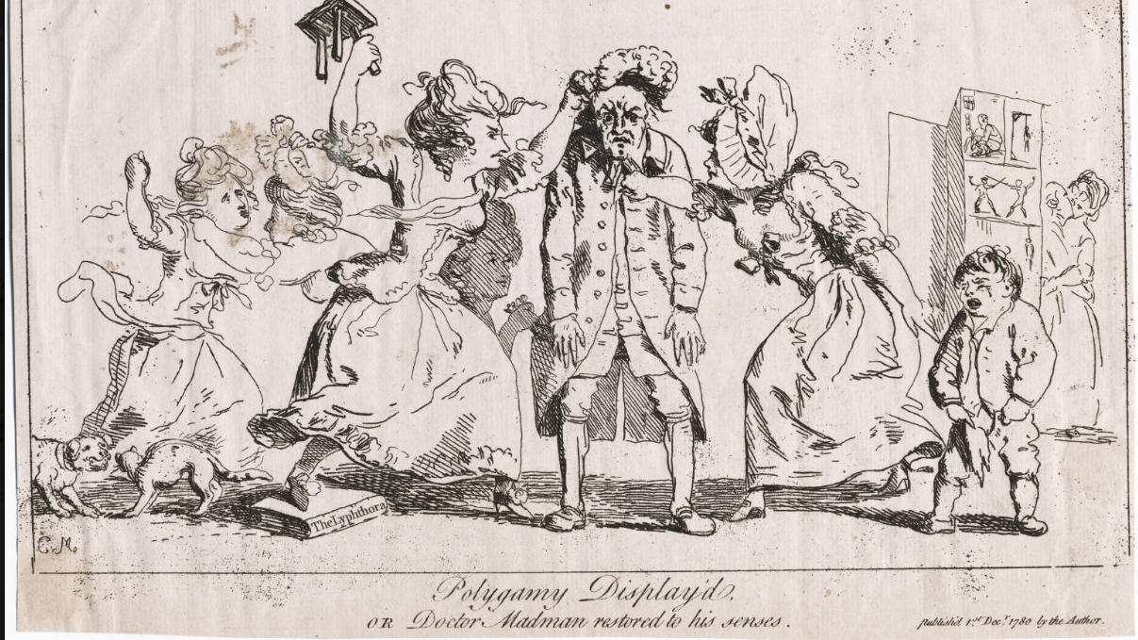

Slide 19
C19th: women less likely to be sentenced to transportation and more likely to receive a short sentence of a month or less
No equivalent narrative about the harm to the second husband

Slide 20
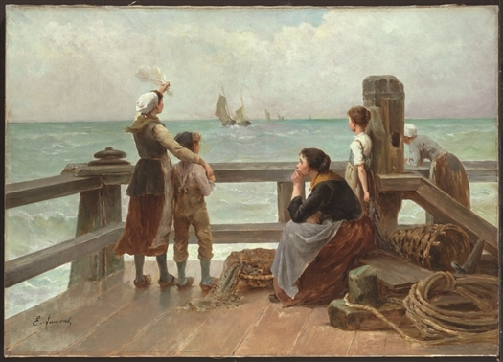
Escaping prosecution

Slide 21
Women as victims

Slide 22
Bigamy as an offence against the person
Mitigated if it had not resulted in the ‘ruin’ of the second wife
  for example if the marriage had not been consummated
  or if the second wife had had sex before the marriage (whether with her husband to be or anyone else)
  or if the second wife had known that the marriage was bigamous

Slide 23
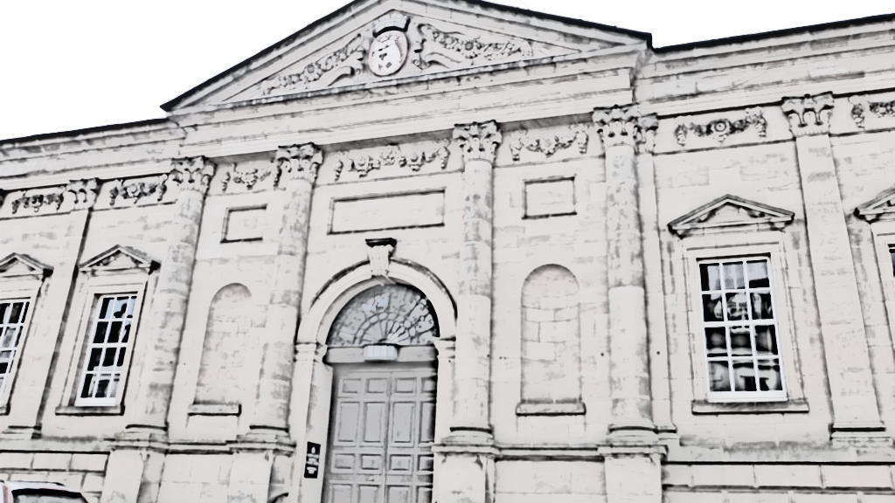
The ‘divorce narrative’ and the erasure of the second wife
1840s: new narrative emerged of the poor man driven to commit bigamy because his first wife had been unfaithful and he had no means of obtaining a divorce
Contemporary campaign for divorce reform glossed over the deception of the second wife in R v Hall
But judges continued to treat bigamists more harshly where they had deceived the second wife
And many bigamists had themselves behaved badly

Slide 24
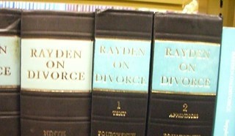
New remedies for the first wife
Matrimonial Causes Act 1857 created a new court with the power to grant divorces
Wives had to prove ‘aggravated’ adultery – such as ‘bigamy with adultery’
  conviction for bigamy was unnecessary
  as was whether the remarrying spouse would have had a defence if they had been prosecuted
This Photo by Unknown Author is licensed under CC BY

Slide 25
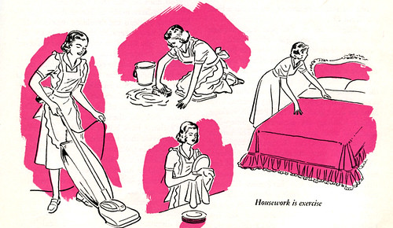
New protection for the second wife
Judicial creativity: breach of promise/warranty
New right to make a claim against the estate of the deceased under the Inheritance (Family Provision) Act 1938
  If the marriage had been annulled (Matrimonial Causes (Property and Maintenance) Act 1958)
  If the claimant had entered into it in good faith (Law Reform (Miscellaneous Provisions) Act 1970)
Judicial rejection of the difference between a decree of nullity and a declaration
This Photo by Unknown Author is licensed under CC BY-NC

Slide 26
Conclusion
Examining the history of bigamy provides an insight into the changing status and rights of women
Nor is it of historical interest only
  Continuing examples of deception and exploitation
  New challenges resulting from religious-only ceremonies of marriage

