Slide 1
WELCOME The Regulatory Approach to Surrogacy in South Africa

Slide 2
PRE-CONCEPTION SURROGATE MOTHERHOOD AGREEMENT
Between commissioning parents/or intended parents and the surrogate mother and her partner.
Brought before High Court of South Africa.
Birth certificate issued in the names of the commissioning parents.
No adoption procedure necessary.

Slide 3
WHICH PERSONS ARE ELIGIBLE TO APPLY FOR SURROGACY?
Heterosexual commissioning parent/s.
Same sex male and female commissioning parent/s.
Single Parent.
Persons who cannot give birth to a child due to their gender such as transgender person/s.

Slide 4
DOMICILE
Commissioning parent/s must be domiciled in South Africa.
Excellent safeguard.

Slide 5
GENETIC LINK REQUIREMENT
Attempt to utilise own genetic material.
Double donor gametes prohibited.
Constitutional Court case AB and SAG vs Minister of Social Development.

Slide 6
COMMERCIAL SURROGACY PROHIBITED
Criminal Prosecution.
Out of Pocket Reimbursement.
Surrogate Mother’s Financial Position.

Slide 7
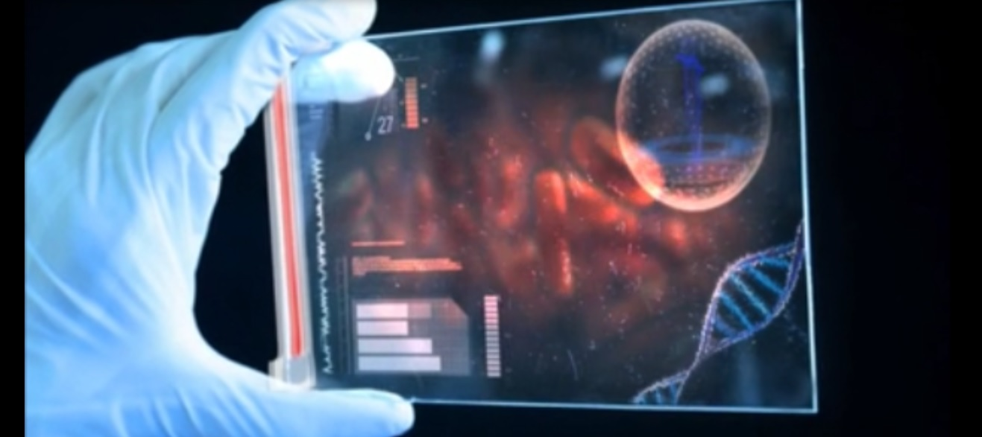
HIV IN THE CONTEXT OF SURROGACY
Increase in demand for surrogacy by HIV postive commissioning parent/s.
Surrogate mother has the right to know the status of the commissioning parent/s.
Consultation held between HIV expert , commissioning parent/s and surrogate mother.

Slide 8
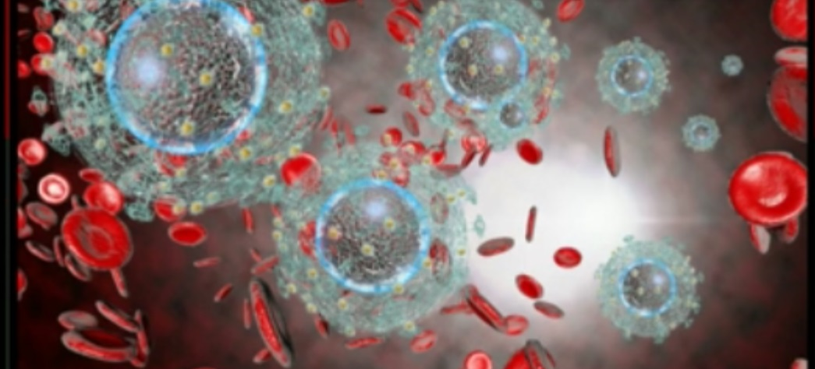
HIV CONTINUED
Commissioning parent/s viral load must be undetectable.
Further consultation with reproductive medicine specialist to discuss sperm washing.
Prevention of onward transmission to surrogate mother.

Slide 9
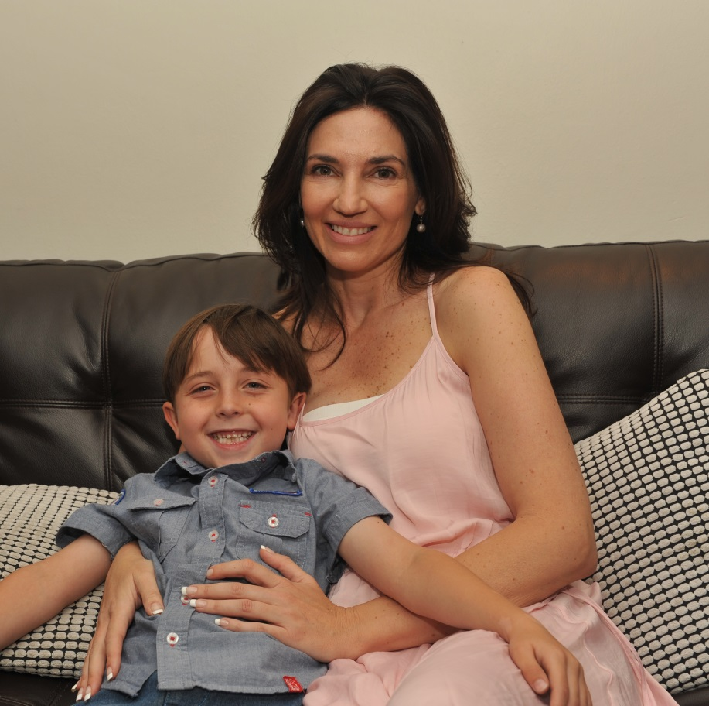
My Personal Journey Through Surrogacy

