Slide 1
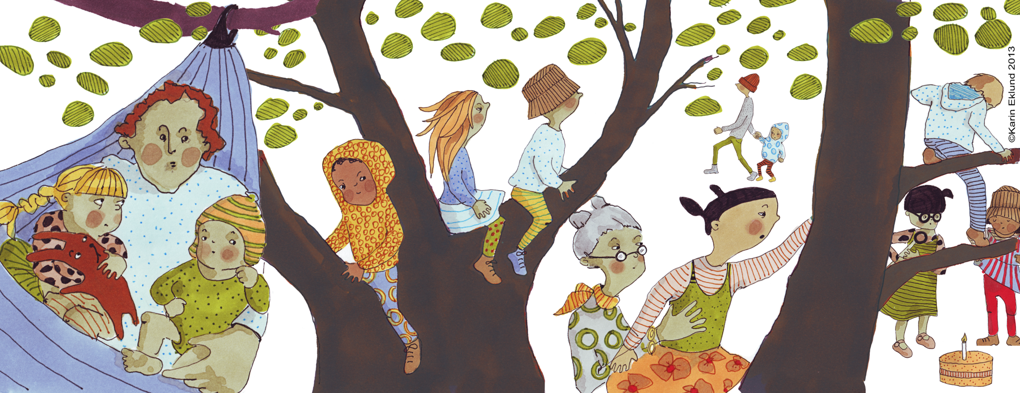

Families formed through surrogacy
Susan Golombok

Slide 2
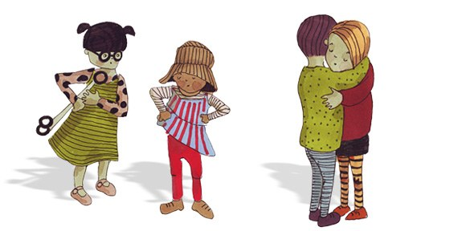
Studies of Surrogacy Families at the Centre for Family Research
Longitudinal study of surrogacy families with heterosexual parents
Study of gay father families formed through surrogacy

Slide 3
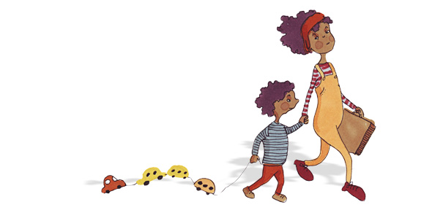
Concerns about surrogacy families
  No opportunity for pre-natal bonding
  Surrogate may remain in contact with family as child grows up
  Disapproval from family and friends
  Psychological harm to children from having been relinquished by surrogate
    Especially if surrogate is the genetic mother and money has changed hands

Slide 4
The Sample
42 surrogacy families
  Recruited through Office of National Statistics and COTS
51 egg donation families
  To control for third party assisted reproduction
80 natural conception families
  Matched as closely as possible to assisted reproduction families

Slide 5
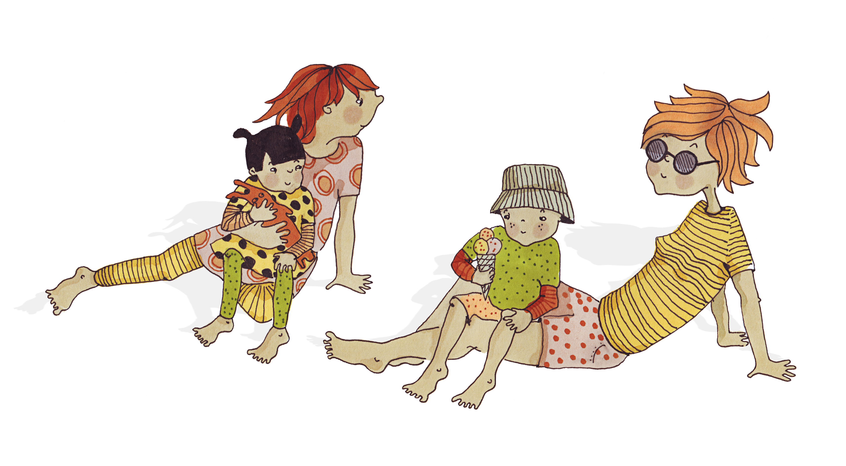
Surrogacy families
38% gestational surrogacy and 62% traditional surrogacy
31% known and 69% unknown surrogates

Slide 6
Research questions
Do surrogacy families differ from egg donation or natural conception families with respect to:
  the quality of relationships between parents and their children
  the psychological adjustment of the children
    How do children themselves feel about being born through surrogacy
How does relationship with surrogate turn out over time

Slide 7
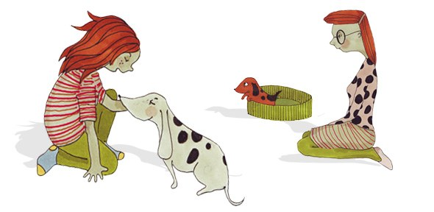
Assessments
All children born at the millennium
Data from mothers, fathers, children & teachers
  Interviews, observational assessments, questionnaires, ratings by child psychiatrist
Assessments at age:
    1 year
    2 years
    3 years
    7 years
    10 years
    14 years

Slide 8
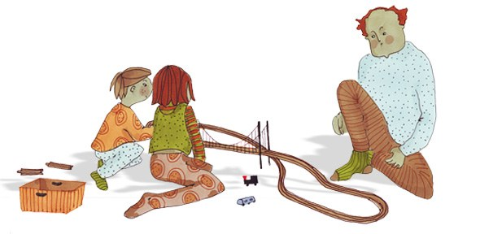
Age 1: Comparisons between surrogacy and natural conception families
Surrogacy mothers and fathers showed greater warmth and sensitivity toward infants and greater enjoyment of parenting
Surrogacy mothers and fathers showed higher levels of emotional-involvement with infants

Slide 9
Age 2: Comparisons between surrogacy and natural conception families
Surrogacy mothers showed greater pleasure in their children and lower levels of anger, guilt and disappointment with their children
Surrogacy fathers showed lower levels of parenting stress

Slide 10
Age 2: Toddler adjustment
No differences in social, emotional or cognitive development identified between three family types

Slide 11
Age 3: Comparisons between surrogacy and natural conception families
Differences identified reflected greater warmth and greater interaction among surrogacy mothers

Slide 12
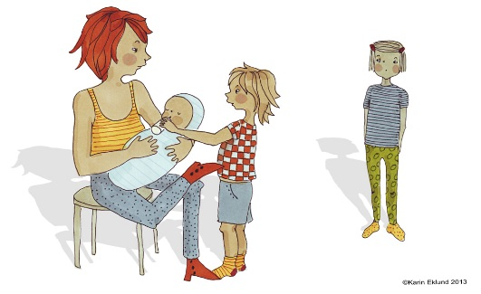
Age 7 assessment
By age 7, children have developed a more sophisticated understanding of biological inheritance and of the meaning of the absence of a biological connection to parents
Almost all parents had told their children about surrogacy by age 7

Slide 13
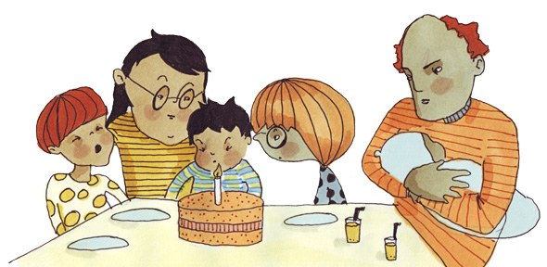
Age 7: Mother-child relationships
No differences between surrogacy mothers and natural conception mothers for interview assessment of quality of mother-child relationships
All family types showed positive mother-child interaction in the observational assessment

Slide 14
Age 7 Child adjustment
Surrogacy children functioning within normal range
However, they showed raised levels of adjustment difficulties compared to children in other family types
Similar to internationally adopted children at age 7 which is attributed to the need to deal with identity issues at an early age

Slide 15
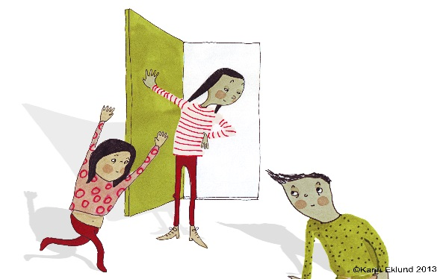
Age 10 Child adjustment
Raised levels of difficulties shown by surrogacy children at age 7 had disappeared by age 10
Same is true of internationally adopted children whose difficulties also declined by adolescence

Slide 16
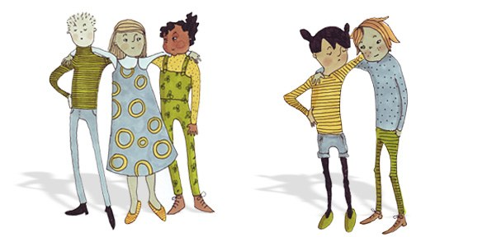
Adolescence
Issues relating to identity and autonomy become salient
Difficulties between parents and children more likely to arise
Adolescence presents specific challenges for adopted children
  Identity and adjustment
Adolescence presents specific challenges for adopted parents
  Communication about adoption

Slide 17
Age 14 Findings
More positive mother-child relationships in surrogacy families
  as rated by mothers and adolescents
Adolescents born through surrogacy showed high levels of psychological adjustment

Slide 18
Children’s relationship with surrogate at ages 7 and 10
  “She was really kind about.… like carrying me in her tummy”
  “I think she is kind and she’s lovely and funny”
  “I feel fine. I don’t feel bad or cross in any way. It’s just pretty much nature so I can’t do anything about it. I wouldn’t like to do anything about it”

Slide 19
Children’s thoughts and feeling at age 14
I don't really mind. It doesn't really affect my daily life.
Fine just normal. I know its like, different but like.....I don't get like emotional or anything, it's just like talking about anything else.
I didn't really care to be honest.
I felt special, and quite privileged really.
I quite like talking about it because it's an interesting fact about me.

Slide 20
Parents’ relationship with surrogate
Parents generally reported a positive relationship with the surrogate from pregnancy to age 10
Frequency of contact declined over time
60% of families still in touch by age 10
Most likely to have lost contact with previously unknown genetic surrogates

Slide 21
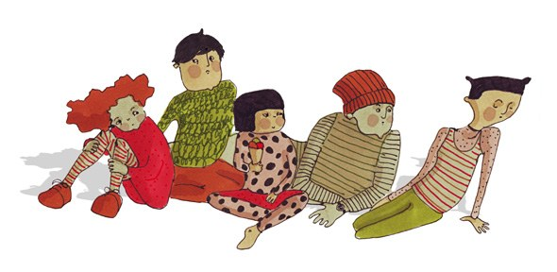
Gay father families through surrogacy
Study in US
  40 gay father families
  55 lesbian mother families
Children aged 3-9 years

Slide 22
Gay father families formed through surrogacy
Children conceived using the egg of a donor, born to a surrogate mother, and raised by two fathers, one of whom lacks a genetic connection to the child.

Slide 23
Design
Gay father families studied in comparison with lesbian mother families formed through donor insemination
  Large body of research showing that children with lesbian mothers do not differ in psychological adjustment from children with heterosexual parents.
  To control for the non-heterosexual orientation of the parents and the use of third-party assisted reproduction

Slide 24
Research questions
Does the quality of parenting differ between gay father and lesbian mother families?
Does the psychological adjustment of children differ between gay father and lesbian mother families?

Slide 25
Findings: Parent-child relationship quality
No differences between gay father and lesbian mother families in positive parenting, negative parenting or perceived stigma
High levels of positive parenting and low levels of negative parenting

Slide 26
Findings: Child adjustment (SDQ)
Low levels of behavioural and emotional problems in children
  Well below general population norms and highly correlated with teachers’ scores
  No differences in behavioural problems
  Lower emotional problems on children of gay fathers
    Not associated with family income

Slide 27
Findings: Ratings by child psychiatrist
No difference in child disorder between family types
  2 children (5%) in gay father families showed a definite disorder
    1 with emotional problems and 1 with behaviour problems
      Below general population norms
  2 children (9%) in lesbian mother families showed a definite disorder
    1 with emotional problems and 1 with behaviour problems
      Similar to general population norms

Slide 28
Factors associated with child adjustment
Perceived stigma, positive parenting and negative parenting were entered into a regression analysis as predictors of children’s emotional and emotional problems
  Higher levels of perceived stigma and higher levels of negative parenting associated with higher levels of behavioural problems

Slide 29
The surrogacy arrangement
36/40 couples used gestational surrogate and egg donor
In 38/40 couples the surrogate was previously unknown
In 36 gestational surrogacy arrangements, almost all couples used a previously unknown egg donor
Majority of donors were open-identity

Slide 30
Contact with surrogate and egg donor
Fathers were more likely to maintain contact with surrogate (85%) than egg donor (31%)
In year preceding the study, 53% of parents had seen the surrogate whereas 8% had seen egg donor
  Also kept in contact through Facebook and email

Slide 31
Quality of relationship with surrogate
Large majority of fathers content with level of contact with surrogate
  Discontent fathers wanted more contact
Only 1 family reported a negative relationship with surrogate
  The others described the relationship in positive or neutral terms
  28% of children who were in contact with the surrogate had a close relationship with her

Slide 32
Quality of relationship with surrogate
“She’ll always be special in our lives, she will always have a place there, we will always remain in contact if she wants to...”
“Our surrogate … is a huge part of our life.”
“We have a great relationship, she is like a relative to us. ...we’re very close to her husband. It was a real bonding experience for us, I think they’re probably some of the closest people to us really…

Slide 33
Quality of relationship with surrogate
“The type of relationship we wanted to have was one of someone who is almost like a family member, but more of like a distant cousin.... it’s more of a sort of distant family member who comes into their lives from time to time.”
“We’re very different people... She’ll always be special in our lives, she will always have a place there, we will always remain in contact if she wants to... the way that we’ve always told the story is that they helped but there isn’t any real direct connection to her.”

Slide 34
Child’s relationship with surrogate
“They love when she comes. They are fond of her and of her sons. She has three sons, and our children just adore them. If she comes, she brings presents, we do something special, we stay up later or we go to the movies, so it is almost like when a godparent visits. To them, it’s always very special and they love it.”
“They get along. He is excited when we go down there and then we spend time with her, and he loves her kids.”

Slide 35
Child’s relationship with surrogate
“Our daughter doesn’t act differently towards her than to other adults that we’ve introduced her to. There are other adults that she has a much closer rapport with than the surrogate.”
“When anyone special comes over to the house, he gets along with them. She and her husband are our special visitors. He doesn’t react to her any differently than he does with other special visitors.”

Slide 36
Disclosure to the child
83% of fathers had begun to tell their children about their genetic origins
Of those, only 30% had disclosed the use of a donated egg
Only 17% had disclosed who was the genetic father
Level of disclosure was associated with the age of the child

Slide 37
Conclusions
The findings of empirical studies of surrogacy families point to positive family relationships and well adjusted children
Family structure – gender, sexual orientation and biological relatedness of parents – matters less for children than quality of family relationships

Slide 38
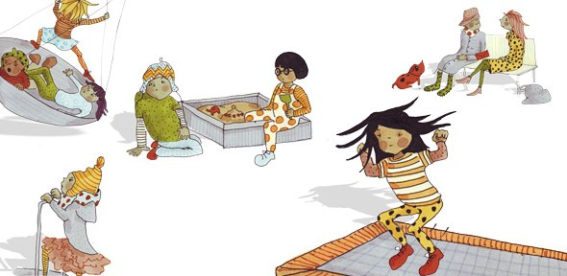
This research was funded by the Wellcome Trust and the US National Institutes for Health

